Slide 1
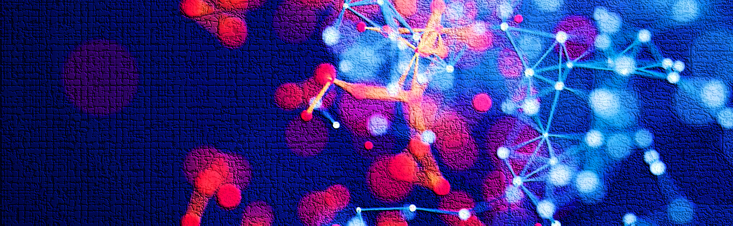
Literature Review

Slide 2

Literature Review
Conventional Method For lung Cancer:
Imaging System : X-rays and CT scan are used to detect the abnormal cell growth in lungs.
Sputum Cytology: Sputum analyzed under microscope to confirm cancer.
Tissue Sample: Tissue cells are analyzed under microscope to confirm cancer. Different method being used for biopsy are Mediastinoscopy, Bronchoscopy, Needle Biopsy.

Slide 3
Literature Review
New method For lung Cancer Detection:
Pathologist need lot of time to study pattern of tissue sample under microscope. To help pathologist machine learning algorithm can be used for detection of the lung cancer. We reviewed the deep learning models used for x-rays and Histopathological images.

Slide 4
Literature Review
Deep Learning methods for lung cancer
W. Ausawalaithong (2018) uses chest X-rays image for detection of lung cancer. Images 224 * 224 , 121 densely CNN, Accuracy 74.43%
T-Atushi (2017) uses cytology images to detect lung cancer. Accuracy 71.1% .
Rhanae in 2018 used CT images to detect type of lung cancer.

Slide 5
Literature Review
Lung cancer Detection using Histopathological images
M. Saric used WSI Histopathological image for detection. Accuracy was 75% for VGG16 model.
Hatuwal et.al (2020) use convolutional neural network to detect lung cancer on histopathology images. Accuracy 97.2 %.

Slide 6
Literature Review
Lung cancer Detection using Histopathological images
S. Garg et.al. (2021) utilizes the pre-trained CNN models to identify lung and colon cancer using LC25000 dataset, Accuracy obtained on the eight pretrained models was between 96-100%.

Slide 7
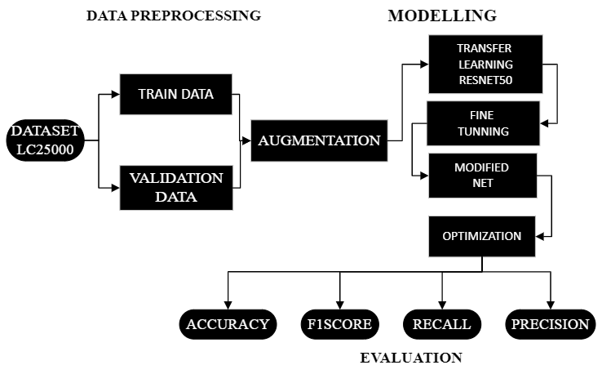

Slide 8
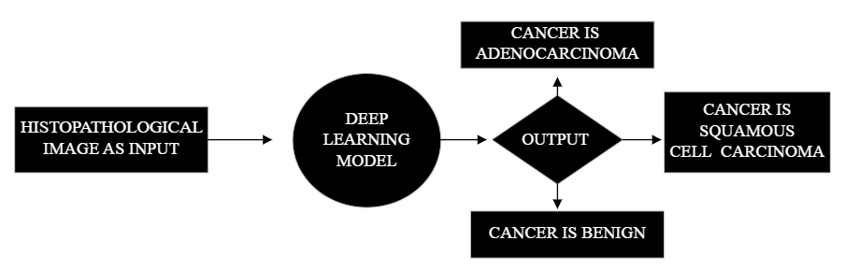
Methodology:

